Slide 1
Appoggio
by Sewan Howsepian

Slide 2
Appoggio -Explanation
What is Appoggio?
Origin - „appoggiare“ (Italian word for leaning on or leaning against)
“To lean on the breath” = supporting or having breath control.
Each inhalation causes the expansion of the rib cage, elevation of sternum and fullness in the epigastric area (that area between sternum and navel). This inhalation gesture is referred as to be the „noble posture“. When you begin to exhale (sing), it is recommended to remain in this inhalation gesture (noble posture) as long as possible in order to keep the ribs expanded, the sternum high.
In other words, trying to keep the inhalation posture while exhaling (singing) is called „appoggio“.

Slide 3
How is appoggio sensed?
Lamperti says:
“The muscles of inspiration must not immediately give in to the muscles of expiration.”
But how can we do that????????

Slide 4
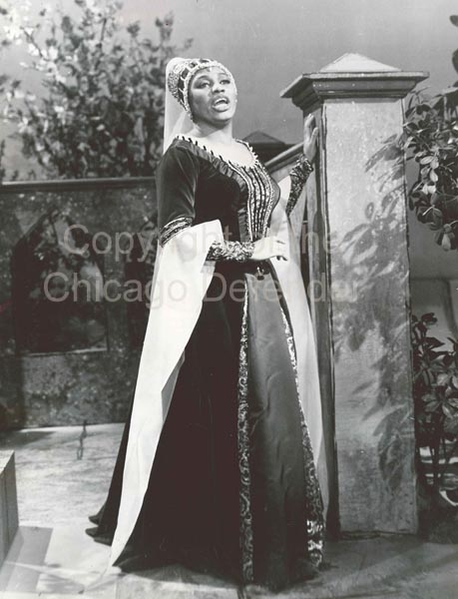
Appoggio - Explanation
Start with a noble posture (sternum relatively high, ribs expanded)

Slide 5

Vocal contest – “la lotta vocale”
La lotta vocale (vocal contest or struggle) – inspiratory muscles (external intercostals) are resisting or battling against expiratory muscles (intern intercostals). If this battle or struggle of these muscles get balanced and reaches a point of equilibrium, well balanced appoggio is the result.
The purpose of this battle is to maintain the inspiratory posture in order to prevent rapid collapse of the rib cage.

Slide 6

The “balloon effect”, when air rushes outwards

Slide 7
Appoggio under anatomical aspects
When air enters the respiratory tract, the pressure below the glottis is lowered, but once we start to sing, speak or cry, the pressure begins to rise.
In other words, sub glottal pressure rises, sternum begins to lower and diaphragm ascends. When sternum falls, the ribcage collapses.

Slide 8
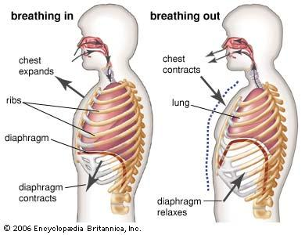
Breathing in and out

Slide 9
Breathing muscles
During expiration the abdominal muscles are responsible to recoil the force of the lungs and the diaphragm.These muscles are the external/internal obliques and the transverse abdominis, which are attached to the rib cage.
While expiration the external intercostals (muscles of inspiration) continue to contract in order to keep the rib cage expanded.

Slide 10
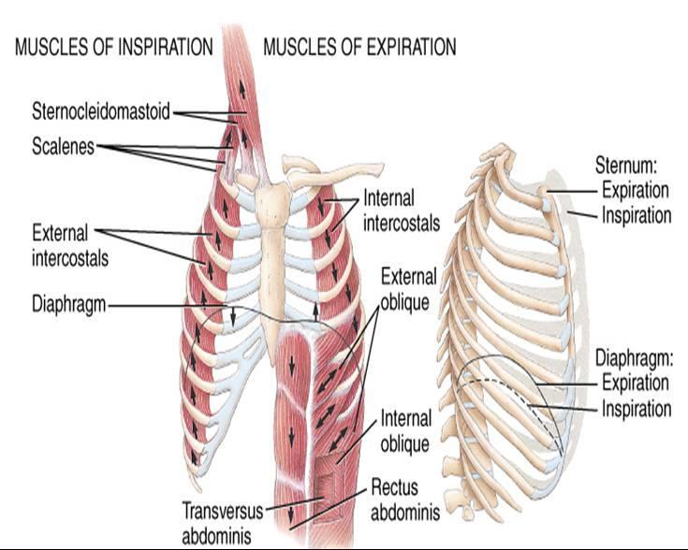
Which muscles are important for exhalation in order to do appoggio?

Slide 11
Suspension
After inhalation, there is a suspension period, which usually lasts less then a second, but if a singer wants to keep the appoggio posture, this is the moment of real action. This moment of suspension could last longer, if the external intercostals (muscles of inhalation) are held in a contracted posture in order to check the recoil forces of the lungs.
Suspension is the moment, when the vocal contest starts.

Slide 12
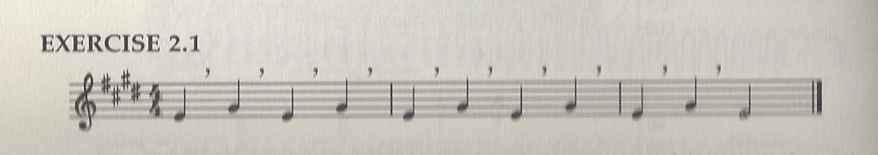
“Appoggio”- Exercise
This exercise is an example for a short onset exercise. The (‘) are “quiet breath renewals” and the flexible awareness of abdominal wall contact. Exercise/sing on a comfortable pitch in the lower middle range.

Slide 13
Breath renewal
The breath is absolutely silent (if possible) and the singer scarcely realizes that breath is being renewed. A feeling of supraglottal pressure is caused and the singer still remains in the inspiratory gesture.

Slide 14
The Experiment
The following experiment should clarify, whether singers with increased body fat have more advantage towards a breathing management; and if yes, are these tendencies correlated to the “appoggio technique”?
Experiment of Hoit and Hixen (1986)
This experiment should clarify if appoggio technique, based on a rib cage/epigastric expansion, is essential for young singers to maintain the right breathing posture.

Slide 15
Experiment
12 female emerging singers, between 18 and 22 years old.
All of the singers had 2 years of vocal study.
In good health with no tobacco use

Slide 16
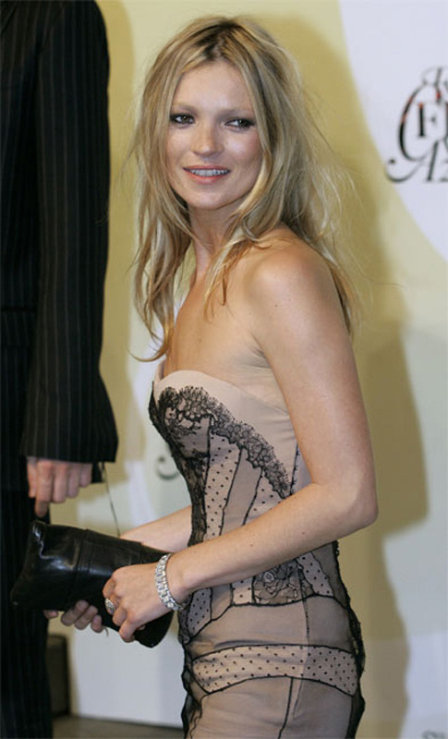
Experiment
12 singers divided into 3 body types
1. Ectomorphs (lean appearance with limited body fat)

Slide 17

Experiment
2. Mesomorphs (more muscles mass than body fat + larger bones)

Slide 18

Experiment
3. Endomorphs (higher percentage of body fat than muscle mass)

Slide 19
3 Methods
Somatotyping
Video recording
Lung Function Assessment
After the 3 methods, a relatively clear result was made by this investigation.

Slide 20
The result
“The singers with more body fat had tendency to breath lower than those who were lean and muscular. The results of the research demonstrate that people in this study with more fat tended to breathe lower in the thoracic region than those who were more lean and muscular (Cowgill 2009)”.
In other words, the endomorph typed singers, had a lower breathing, which correlated with the “appoggio technique”.

Slide 21
Author’s conclusion
“These findings demonstrate that 1) singers with different body types do tend to breathe differently, and 2) that beginning level singers of every body type show a prominence of large vertical chest breaths. Knowing which body types have which breathing tendencies will be helpful for the teacher of singing in determining where to look for each student’s breath movement and in guiding the student accordingly (Cowgill 2009)”.

Slide 22
What the vocal experts say about appoggio?
The singing in reality is born to clash of opposing principals, the tension of the conflicting forces, brought to equilibrium.
He further indicates about appoggio, that air needs to escape to feed the pulsation of the glottis, but the lungs should never collapse, otherwise singing is ineffectual.
Therefore only the compressed air of the escaping air will feed the pulsation in the throat correctly. The lungs then never collapse and the voice will never fail. Lamperti thinks, that compressed air is a well balanced co-ordination, which has to be guided and restrained. When this co-ordination of muscles is well done, the throat opens naturally, as talking.
“There is no attack no mouth position, no tongue control, no voice placing, no fixed chest, no relaxing this or that muscle, no stiffening any part of the body, in fact, nothing that would not spring from instinctive utterance”.

Slide 23
William Shakespear about appoggio
appoggio (control of breath) means, supporting the voice and the voice, if fully responding to this, is said to be appoggiata, or leaning on the breath. Ben appoggiata = well supported.
A singer should feel, like the breath is pressed out, but still remains in the body. If the breath rushes outwards, the throat is held rigidly. A singer should sing with breath reserves, especially when ending a phrase. That way the quality of voice will be preserved and the breath renewal will be under control.
To finish the tone or phrase appropriately well appoggiated, the singer has to feel, like arresting the breath.
A siinger’s original background and language could cause several problems in the vocal technique

Slide 24
William Vennard
Was that he was not using the terminology “appoggio” in order to explain it. Instead he is using the terminology of “breath control”.
inhalation should be quick and intentional, while as exhalation be slow and subconscious. The intercostals and the diaphragm should resist the abdominals so that exhalation will be slow and steady.
The epigastrium is somehow bulging outwards and a pushing out of the breastbone, should be more of interest.
Sitting on the breath or holding it can cause a lot of confusion.
breath control” (appoggio), should be not be taught until a free flowing tone is mastered.

Slide 25
Clifton Ware
Cilfton Ware uses the “lotta vocale” or the “vocal contest” to explain appoggio
find the moment of “suspension breath of balanced pressure”.
“To prevent the collapse of the respiratory system at the beginning of singing and to maintain a coordinated balance between inspiratory and expiratory forces, the following image might be helpful: While singing a phrase or exercise, imagine that by the action of your rib cage – plus the muscles surrounding the waist and back – you are able to keep the walls of the room from collapsing inward. Similarly, when taking a breath, imagine filling the space of the room with your expanding breath (Ware 1998)

Slide 26
Conclusion
This technique is a co-ordination of many muscles forces, acting as antagonists to each other, in order to maintain the inspiratory posture.
Being able to keep the inspiratory posture until the end of a phrase, will allow the singer to find the beauty and freedom in the voice. By maintaining the inspiratory posture, the diaphragm remains relatively low and the sternum relatively high, which is very beneficial for singers to vocalize well.
The abdominals act as additional supporters, by moving inward to build the antagonist to the thoracic muscles. It is strongly recommended to not force the abdominals inward; otherwise the thoracic muscles will collapse.
By spending many hours, weeks and years, to observe and discover the mystery of the appoggio technique, it will still be a very delicate work, which needs a specific period of time to be perfected.

