Slide 1
Chapter 2
Foundations of Singing
Breath and the Body

Slide 2
How should I stand while singing?
Heels few inches apart from each other (see pictures on page 7 in your book).
Legs straight, but not stiff
Torso: Hips and shoulders on one level.
Shoulders relax in back and downward position.
Neck and head weightlessly rising towards ceiling. But keep your eye level straight ahead.

Slide 3
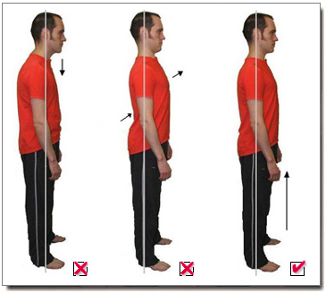

Slide 4
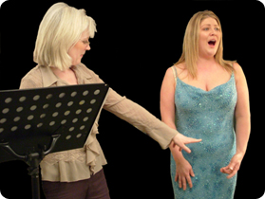
Correct Posture

Slide 5
This is breath control
Singing long musical phrases depends on (1) volume of air in the lungs and (2) the ability to release it steadily.
Singing softer or louder depends on the abilitiy to vary the rate of airflow. (the more air, the louder).
Tone quality depends on transforming breath into tone without vasting any air.
Quick breaths inbetween phrases, renews our enery for breathing.

Slide 6
Exhaling and Inhaling muscles
Different groups exhaling and inhaling muscles, mostly out of sight, are involved in the breathing mechanism. They are interacting with each other, in order to make exhaling and inhaling possible. They also help us to understand breath support for singing.
Let‘s practice ….

Slide 7
Exahling
Exercise:
Push as much air you have out of your body by squeezing your ribs in on both sides, using your elbows to help.
Pull in your abdominal muscles at the same time.
Hold this position for 3 to 4 seconds.
Relax

Slide 8
What do you feel?
Discussion

Slide 9
Internal intercostal muscles
Internal intercostal muscles are those muscles, which pull the ribs down.
These muscles help to push the air out of your body.

Slide 10
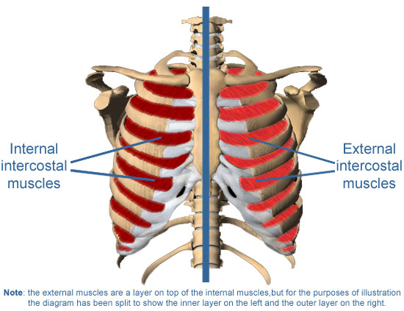
Internal intercostal muscles – Exhaling muscles

Slide 11
Abdominal muscles
Abdominal muscles pull in in your tummy and keep it from bulking out.
Abdominals help to dose the air being exhaled. The more the abdominals are pushed in, the more the air will be hold back inside of your body. This knowldedge helps the singer to prevent too much air being exhaled, while singing. Which, on the other side, will produce a quality tone.

Slide 12
Inhaling
Widen up your rib cage from side to side.
Push ribs outwards
Relax abdominals same time
Hold for 3 to 4 seconds
Afterwords let your abdominals pull in slowly, pushing the breath out of your body.
Ribs will return back to their relaxed position.
Repeat this action several times.

Slide 13
What did you feel?
Discussion

Slide 14
External intercostal muscles
These muscles help to pull air into the body
External intercostal muscles lift the ribs and move outwords. They move upward and back. This mechanism helps to widen the ribcage.

Slide 15
External intercostal muscles – Inhaling muscles

Slide 16
Diaphragm
The diaphragm is the second goup of muscles, which helps pulling air into the body (inhaling).
When diaphragm acts, it pushes down on the viscera (abdominal organs).
In simple words: When inhaling the diaphragm goes down and when exhaling the the diaphragm returns up to its relaxed position. (see picture on the next slide)
No direct control of diaphragm, because it has no proprioceptive nerves, which would inform the brain.

Slide 17
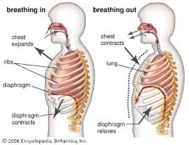
Diaphragm while inhaling and exhaling.

Slide 18
Breath Support
Inhaling muscles work against exhaling muscles, in order to produce a free and balanced tone. This mechanism is called antagonism. Muscles fight against each other, in order to produce a balance.
Inhaling muscles, such as the diaphragm pushes down the abdominals, which are the exhaling muscles. This mechanism is called antagonism of the breating muscles.

Slide 19
Breath Support
This balancing-out of those muscles goups must be learned step by step.
If vocal tone is too breathy, air is being wasted, abdominals are too weak.
If the sound is pressed, then abdominals are being held excessively and need to be relaxened.
If the perfect balance between those muscles is reached, we call it „breath support“ or „well supported singing“.

Slide 20
Exercises
Class exercise
(The exercises in the book are highly recommended)

